Slide 1
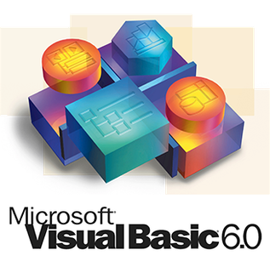
VISUAL BASIC

Slide 2
CONTENTS
INTRODUCTION
FEATURES OF VB
APPLICATION OF VB
IDE
VB STRUCTURE

Slide 3
INTRODUCTION
Visual Basic is a 3RD generation event-driven programming language first released by Microsoft in 1991. It evolved from the earlier DOS version called BASIC. BASIC means Beginners‘ All purpose Symbolic Instruction Code. Since then Microsoft has released many versions of Visual Basic, from Visual Basic 1.0 to the final version Visual Basic 6.0. Visual Basic is a user-friendly programming language designed for beginners, and it enables anyone to develop GUI window applications easily.

Slide 4
FEATURES OF VB
It is a object based and event-driven programming language.
Visual Basic was derived from BASIC and enables the rapid application development (RAD) of graphical user interface (GUI) applications, access to databases using Data Access Objects, Remote Data Objects, or ActiveX Data Objects, and creation of ActiveX controls and objects.
Forms are created using drag-and-drop techniques.

Slide 5
An Empty Form in VB

Slide 6
APPLICATIONS
Visual basic can mean more than one thing.
It is programming tool for creating window GUI Apps.
VB Applications is a version of VB that is used to programs of office apps such as Access, Excel, Word and Power point.
VB. NET is a part of .net and is a powerful programming language that is made needlessly complex by using the .net framework

Slide 7
INTEGRATED DEVELOPMENT ENVIRONMENT
An integrated development environment (IDE), also known as integrated design environment and integrated debugging environment, is a type of computer software that assists computer programmers to develop software. In the case of Visual Basic .NET, that IDE is Visual Studio.

Slide 8
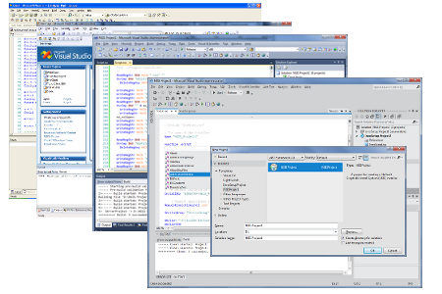

Slide 9
IDE CONTENTS
Toolbox
Solution Explorer
Properties Windows
Object Browser

Slide 10
Tool Box
The Toolbox is a palette of developer objects, or controls, that are placed on forms or web pages, and then code is added to allow the user to interact with them.
An example- TextBox, Button and ListBox controls. With these three controls added to a Windows Form object the developer could write code that would take text.

Slide 11
Solution Explorer
This is a section that is used to view and modify the contents of the project. A Visual Studio Windows Application Project will generally have a Form object with a code page, references to System components and possibly other modules with special code that is used by the application.

Slide 12
Properties Window
The properties windows shows all the control (like TextBox) properties to be changed at design time. Most of these properties can be also changed with code at run time, but basically most properties change the way the control is displayed on your application.
Object Browser
By pressing F2 or selecting it into the View menu, it's possible to explore all the available objects of the libraries (types, functions...).

Slide 13
VB STRUCTURE
Variable declaration types
User defined data types
Scope and life of a variable
Array
Constructors
Control flow statements
Procedures and function

Slide 14
Variable Declaration Types
To declare a variable to specify its name and characteristics. The declaration statement for variables is the Dim Statement. Its location and contents determine the variable's characteristics.
Declaration Levels
Local and Member Level
A local variable is one that is declared within a procedure. A member variable is a member of a Visual Basic type; it is declared at module level, inside a class, structure, or module, but not within any procedure internal to that class, structure, or module.

Slide 15
Shared and Instance Variable
In a class or structure, the category of a member variable depends on whether or not it is shared. If it is declared with the Shared keyword, it is a shared variable, and it exists in a single copy shared among all instances of the class or structure.
Otherwise it is an instance variable, and a separate copy of it is created for each instance of the class or structure

Slide 16
User defined data types
A user defined type, or UDT, is a VB technique for defining a data type that exactly meets the needs of your program. A UDT can contain two or more individual data items that can be of different types, such as String and Integer. A UDT can even contain other UDTs and arrays. You can also create arrays of a UDT.
To define a UDT, use the Type...End Type statement, which must appear in the declarations section of a code module. Within the statement, you define the individual items, or members, that the UDT will contain

Slide 17
SCOPE AND LIFE OF A VARIABLE
A Variable’s Scope : The scope of a variable is the section of the application that can see and manipulate the variable. If a variable is declared within a procedure, only the code in the specific procedure has access to that variable. When the variable’s scope is limited to a procedure it’s called local.

Slide 18
ARRAY IN VB
An array is a set of values, which are termed elements, that are logically related to each other. For example, an array may consist of the number of students in each grade in a grammar school; each element of the array is the number of students in a single grade. Similarly, an array may consist of a student's grades for a class; each element of the array is a single grade.
For example, if our application analyzes student grades, we can use a separate variable for each student's grade, such as englishGrade1, englishGrade2, etc.

Slide 19
CONTROL FLOW STATEMENT IN VB
Control Statements are used to control the flow of program's execution. Visual Basic supports control structures such as if... Then, if...Then ...Else, Select...Case, and Loop structures such as Do While...Loop, While...Wend, For...Next etc method.If...Then selection structure
The If...Then selection structure performs an indicated action only when the condition is True; otherwise the action is skipped.
Syntax of the If...Then selection
If <condition> Then statement End If
e.g.: If average>75 Then txtGrade.Text = "A" End If

Slide 20
PROCEDURE AND FUNCTIONS IN VB
We use procedures and functions to create modular programs. Visual Basic statements are grouped in a block enclosed by Sub, Function and matching End statements. The difference between the two is that functions return values, procedures do not. A procedure and function is a piece of code in a larger program. They perform a specific task. The advantages of using procedures and functions are:
Reducing duplication of code
Decomposing complex problems into simpler pieces
Improving clarity of the code
Reuse of code
Information hiding

Slide 21
PROCEDURE
A procedure is a block of Visual Basic statements inside Sub, End Sub statements. Procedures do not return values.
Option Strict On
Module Example
Sub Main()
SimpleProcedure()
End Sub
Sub SimpleProcedure()
Console.WriteLine("Simple procedure")
End Sub
End Module

Slide 22
FUNCTION
A function is a block of Visual Basic statements inside Function, End Function statements. Functions return values.
There are two basic types of functions. Built-in functions and user defined ones. The built-in functions are part of the Visual Basic language. There are various mathematical, string or conversion functions.

Slide 23
FUNCTION IN VB

Slide 24
THANK YOU

